Slide 1
Celebrating the Seasons of Life
The message from the Proverbs 31 Woman “Financial Advising”

Slide 2
The Virtuous Woman
Words that describes the Virtuous Woman?
Faithful to God
Loving Wife
Business-women
Trustworthy
A Servant
Wise
Hard worker
Smart
Good manager
Industrious
Positive influence
A giver
Loving Mother

Slide 4
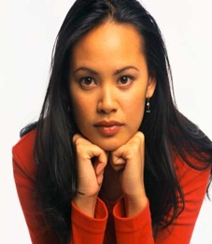
Characteristics of the Virtuous Woman
The characteristics of a Proverbs 31 mother include her virtue, her values,
her trustworthiness, her love for others and her love for her family. She does
good and no evil. She is a worker, a businesswoman,
the household manager and a provider.
She loves hospitality and generously provides tasty meals for her family.
I WOULD SAY, THIS SISTER IS MULTI-TALENTED

Slide 5
What are the talent(s) that God has given you?
Matthew 25:14-30
¹⁴ “For it will be like a man going on a journey, who called his servants and entrusted to them his property. ¹⁵ To one he gave five talents, to another two, to another one, to each according to his ability. Then he went away. ¹⁶ He who had received the five talents went at once and traded with them, and he made five talents more. ¹⁷ So also, he who had the two talents made two talents more. ¹⁸ But he who had received the one talent went and dug in the ground and hid his master's money.

Slide 6
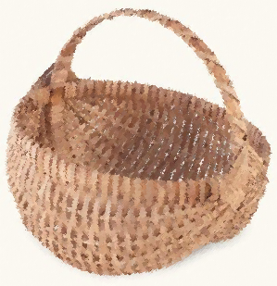
Sewing Arts and Crafts Basket weaving I meet no stranger Quick to smile
Operate within your talent(s)

Slide 7
^{Proverbs 31: 10 – 11} ¹⁰ Who can find a virtuous woman? for her price is far above rubies. ¹¹ The heart of her husband doth safely trust in her, so that he shall have no need of spoil.

Slide 8
GEM FACTS: Generally speaking, rubies are more expensive than diamonds due to its rarity. Proverbs 3:5-6 Trust in the Lord with all your heart, and do not lean on your own understanding. In all your ways acknowledge him, and he will make straight your paths.

Slide 9
She is not impetuous, her thoughts are not scattered, or unpredictable about money. Rather, she can be trusted. Her husband trust her judgement and can be confident in her. She will never deliberately let
the family down.

Slide 10
Educating Ourselves is Critical

Slide 11
Rejecting knowledge can have an impact on your finances
Hosea 4:6
“My people are destroyed for lack of knowledge: because thou hast rejected knowledge, I will also reject thee, that thou shalt be no priest to me: seeing thou hast forgotten the law of thy God, I will also forget thy children.”

Slide 12
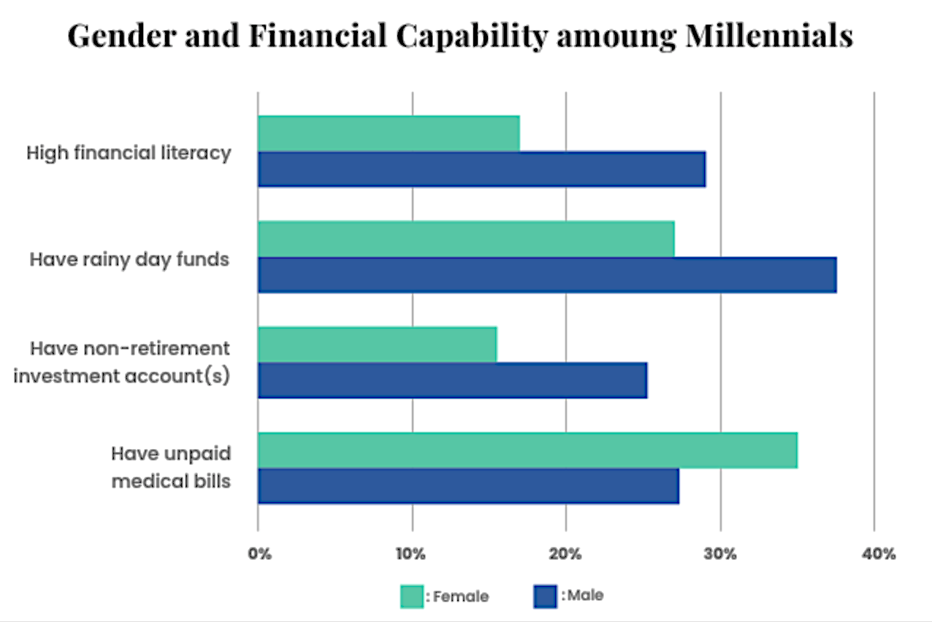
State of Women and Money in 2022
Facts you should know…
Women making up 47% of the workforce, compared to 38% in 1970
On average, women are paid less, making about 17% less than men working full time.
Women are still responsible for most of the caregiving, including childcare and helping elderly parents, which impacts their lifetime earning potential.
Women also tend to be more negatively impacted financially by divorce.
We tend to have less saved for retirement.

Slide 13
In all Your Getting Get Understanding Proverbs 4:7 - KJV
The Proverbs 31 women was a businesswoman
She seeks the best at the best price, setting an example of financial stewardship for those around her.
The profit from her homespun items affords her choice selections of goods.
She cares for her family’s health

Slide 14
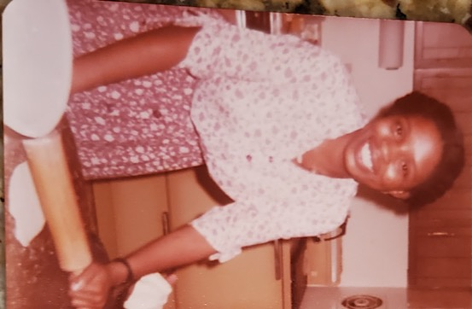
•• She “worketh willingly with her hands” (KJV). She is “willing to get her hands dirty”, a woman of God is not “above” hard work.
Vs. 14 She is like the merchant ships, bringing her food from afar.
•• She understands that the duties of a wife and mother include ensuring that her family is well fed.
•• A virtuous, biblical woman, will excel in this area. She learns the necessary cooking skills, but she will study sound nutrition and will ensure that her family is fed nutritiously, not with a high proportion of out-of-the-box junk food.

Slide 15
Vs. 16 She considers a field and buys it; out of her earnings she plants a vineyard Vs. 17 She sets about her work vigorously; her arms are strong for her tasks. Vs. 18 She sees that her trading is profitable, and her lamp does not go out at night.
Not only was the the Virtuous Women God-fearing, but she was also frugal, an investor, talented, industrious, and generous.
As women it’s important that we have a good understanding of our finances; life happens.
Good Money Management
Understand the Credit Reporting Process
FICO Scoring System

Slide 16
Managing Your Finances
Managing your finances may seem natural; however, the truth is that it can be downright overwhelming and often comes with emotional baggage.
While some people have been privileged never to have had to worry about money, others associate money with stress, a lack of security, and even feelings of unworthiness.
These negative relationships to money—are often formed by early childhood experiences—and can be connected to financial trauma, which can, in turn, inform and hinder how we interact with our money daily.

Slide 17
Our negative relationship with money is called Financial Trauma
Financial trauma is a financial wound or injury that can
cause disruptive behavior with the way in
which we handle our money.
Philippians 4 13: I can do all things through Christ which strengthened me.
Matthew 6:33: But seek ye first the kingdom of God, and his righteousness; and all these things shall be added unto you.

Slide 18
Financial Trauma
Financial trauma can be a combination of any number of circumstances.
The inheritance of toxic money beliefs
Chronic debt
Sudden loss of a job
Loss of a home
Unstable income
Chronic inability to pay all of the bills
Low-wages
Entering the job market during a global pandemic and recession

Slide 19
Nearly one in four Americans suffer
from PTSD-like symptoms caused
by financial induced stress.

Slide 20
Signs of Financial Trauma?
Chronic financial anxiety (things like overspending, avoidance, etc.)
Physical stress over social outings, out of fear of spending money
Isolating from relationships, out of fear of spending money
Negative thought patterns around money
Limiting beliefs around money

Slide 21
Money Stories? Proverbs 22:6 Train up a child in the way he should go: and when he is old, he will not depart from it.
We have a responsibility to teach money management skills to our children
Everyone has a money story—often our plotline has alternative truths and conflicts.
Our relationship with money, has its own history, develops its own story, and evolves into its own language.
Even though we may talk about money regularly, think about it, we may not know how to clearly and simply tell our money stories to ourselves to see what needs to change.

Slide 22
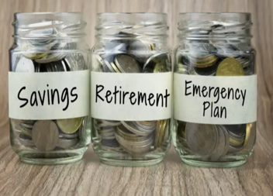
Understand the Financial System
Stretched
Sowed
Saved

Slide 23
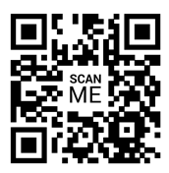
Credit Stats and Women
Thirty-seven percent of women have $100 or less in their savings account versus just 28% of men. https://www.gobankingrates.com/banking/savings-account/40-percent-women-have-less-than-100-in-savings-accounts-new-survey-finds/
Women hold an average of $31,276 in student debt, leaving them with a monthly loan payment of $307 the year after graduation.
Despite ongoing gender and social disparities, women's and men's FICO scores, on average, are almost identical (704 and 705, respectively).
Women pay $142 more per year than men for car ownership on average and can pay up to $7,800 more during the length of ownership. https://www.yahoo.com/video/women-pay-8k-more-men-190001588.html
AnnualCreditReport.com
Equifax, Experian and TransUnion
$FREE
MYFICO.COM
Monthly Fee $29.95
Notes:
Verify the accuracy of this information. Incorrect information could have an impact on the report. Correct all incorrect data.

Slide 24
Credit Impacts Every Aspect of Your Life
Employment
1
Housing
2
Insurance
3
1
2
3
4
Utility

Slide 25
Credit Scores & Reason Codes
Notes:
FICO® scores are calculated from many pieces of data in your credit report. This data is grouped into five categories: Payment history (35%), amounts owed (30%), length of credit history (15%), new credit (10%), and credit mix (10%).
Reason codes (also known as {adverse action notices}) are the top four reasons why a creditor would have declined a credit application by a consumer based on their credit history.

Slide 26
Tradeline Information
Inquires
Notes:
A tradeline is a credit account. Tradelines are used to comprehensively calculate your credit score. This section shows revolving and installment accounts. Information is provided on when each account was opened, loan amount, credit limit, monthly payment, and current status. It shows if the amount was paid in full and/or how many times it was delinquent. Review this section to ensure accuracy.

Slide 27
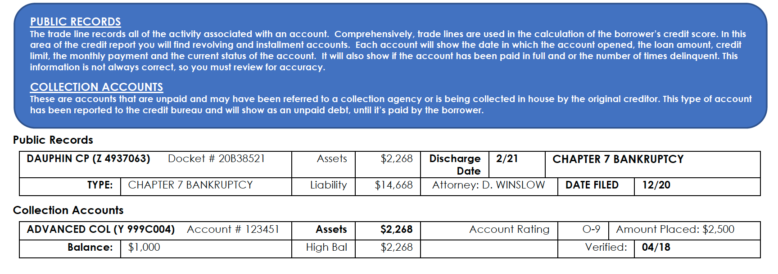
Public Records and Collections
Notes:
These are accounts that are unpaid and may have been referred to a collection agency or are being collected in-house by the original creditor. This type of account would have been reported to the credit bureau and will show as an unpaid debt until it’s paid by the {borrower}.

Slide 28
Credit Data Shelf Life
Item | Length of time item REMAINS on the Credit Report
Positive Credit Information | 7 years
Late Payments | 7 years
Collection | 7 years from the date of collection or charge off
Chapter 13 Bankruptcy | 7 years
Chapter 7 Bankruptcy | 10 years
Foreclosure | 7 years
Public Records | 7 years
Unpaid tax liens | Can remain indefinitely

Slide 29
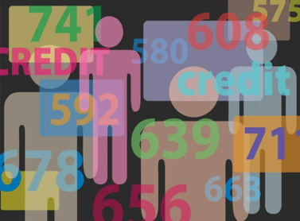
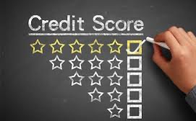
Understanding FICO Scoring System

Slide 30
Credit Scoring
Credit Scoring - is a grading system that adds or subtracts points based on select data in a credit report.
Driven by the financial industries desire for an equitable method of comparing the credit worthiness of borrowers, Fair Isaac & Co developed a credit measurement tool in the 1950’s called the FICO® score

Slide 31
WHAT MAKES UP YOUR CREDIT SCORE?
MIX OF CREDIT
Installment (raises) and revolving (lows)
The more finance company loans the lower the scores.
CreditSmart®️ Essentials
CAPACITY
Percentage of credit limit available
ACCUMULATION OF DEBT
In the last 6 – 18 months:
- Number of credit inquiries
- Opening dates
PAYMENT HISTORY
Ontime payments or delinquencies. More weight on current payment history
LENGTH OF CREDIT
How long have you had a credit presence?

Slide 32
The Cost of Having Poor Credit
10/29/2022
www.diversifiedresourcenetwork.org
32

Slide 33
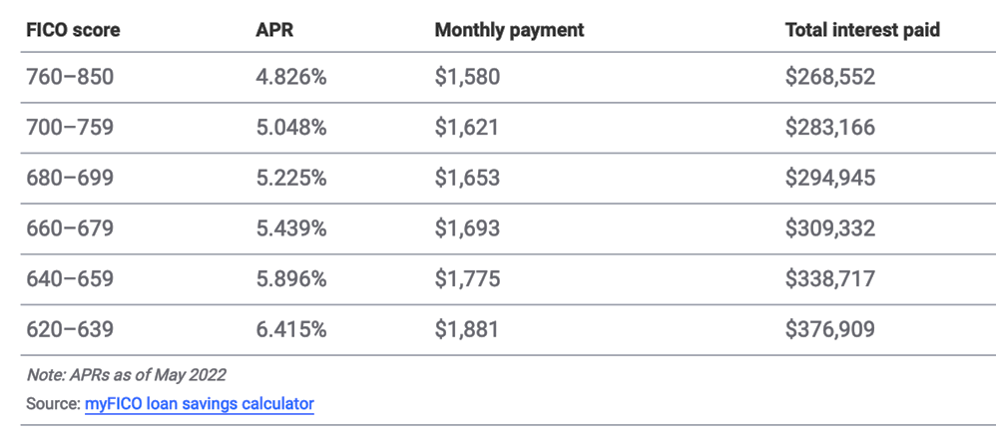
Buying a Home
https://www.bankrate.com/mortgages/amortization-calculator/

Slide 34
Buying a Car
When buying a car, lenders will usually charge a higher interest rate if the credit score does not meet their guidelines.
For example, in 2021 someone with low credit score (which Experian defines as scores of 501 to 600) received an average interest rate of 11.33% for a new vehicle and 17.78% for a used one.
However, with a credit score between 670 – 799; the interest rate could fall between 3.6 - 4.6% for a new car – and 6 percent on a used car.

Slide 35
Addressing Credit Problems

Slide 36
Addressing Credit Problems
Inaccuracies – Make sure that the information reported in the report is true and accurate. Don’t be afraid to dispute anything that’s inaccurate.
Past Due Accounts – Start with baby steps, pay at least a full payment not a partial payment.
Collections – Verify if the debt belongs to you, consider negotiating, get in writing, keep a record of all conversations and all documentation.
Repossessions – Always verify/dispute the balance.
Bankruptcy – Review your credit report, make sure that the accounts included in the bankruptcy are being reported as included.
Be Strategic In Your Approach – Understand the rules of the game, it’s just like basketball☺

Slide 37
Don’t be SCAMMED
Beware of BNPL
Romance Scams are on the rise
Unsolicited OFFERS
Decisions that must be made TODAY
Investment Scams
If it sounds too good to be true, it is☹

Slide 38
REMEMBER…

Slide 39
It’s All God’s
“The earth is the Lord’s, and everything in it. The world and all its people belong to him.” Psalm 24:1
The word ‘money’ occurs 140 times in the Bible. Think about it.
Why would God spend so much time addressing a topic he didn’t care about?
God knows poor money management leads to financial disaster. And he wants us to have a bright future.

Slide 40
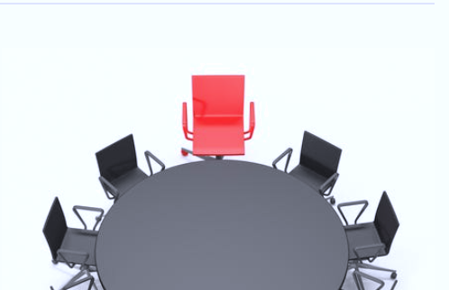
Good Steward of Money?
The first step of becoming a good steward of money means you must accept God as the owner.
When you’re sitting down to plan out your family budget, make sure God has a seat at the table.

Slide 41
Resource Directory
Notes:
Shanika 82 – 92

Slide 42
National Resources
Freddie Mac CreditSmart Essentials https://creditsmart.freddiemac.com/?gclid=Cj0KCQiA64GRBhCZARIsAHOLriIQ_DJJTOmUFW-PR4XV_nF16od8o4u0fuhfZFSrEa9aIEa03NoqlSoaAnZqEALw_wcB
Freddie Mac HomebuyerU - https://creditsmart.freddiemac.com/paths/homebuyer-u/?gclid=Cj0KCQiA64GRBhCZARIsAHOLriJvlHWKZgIleTUtoyMwnoGwTaxdr9Q4eIaIvlMPcqEuNpm-2mE1ZMUaAoFLEALw_wcB
Diversified Resource Network Consumer page - https://diversifiedresourcenetwork.org/credit-score/
HUD Housing Counseling Agencies – https://apps.hud.gov/offices/hsg/sfh/hcc/hcs.cfm
Federal Trade Commission – (FTC) – https://www.ftc.gov/faq/consumer-protection/submit-consumer-complaint-ftc
Annual Credit Report – www.annualcreditreport.com

Slide 43
Student Loan Resources
Consumer Debt Counselors - https://www.consumerdebtcounselors.org
FinAid.org www.finaid.org/loans
Federal Student Aid https://studentaid.ed.gov/sa/
Student Loan Borrower Assistance Project www.studentloanborrowerassistance.org
Direct Federal Student Loan Consolidation https://studentaid.ed.gov/sa/repay-loans/consolidation
NSLDS https://nslds.ed.gov/nslds/nslds_SA/
US Dept of Education’s Debt Collection Service www.ed.gov/offices/OSFAP/DCS
CFPB - Choosing a loan that's right for you https://www.consumerfinance.gov/paying-for-college/chooseastudentloan/?_gl=1*1limgiz*_ga*MTMzOTc2NjMyNS4xNjM1NjM1NzAz*_ga_DBYJL30CHS*MTY0NDU3MTUxMC4xMi4xLjE2NDQ1NzE1OTMuMA..#o1
Public Service Loan Forgiveness www.studentaid.ed.gov/publicservice

Slide 44
Consumer Rights Resources
Fair Credit Reporting Act – Summary https://www.consumer.ftc.gov/articles/pdf-0096-fair-credit-reporting-act.pdf
Equal Credit Opportunity Act http://files.consumerfinance.gov/f/201306_cfpb_laws-and-regulations_ecoa-combined-june-2013.pdf
Fair Debt Collection Practices Act http://www.consumer.ftc.gov/articles/0149-debt-collection
Fair Credit Billing Act http://www.consumer.ftc.gov/articles/0219-disputing-credit-card-charges
January 28, 2023
Sister to Sister Lectureship Retreat – Arlington Road Church of Christ
44
Notes:
REVIEW RESOURCES
----------------------

Slide 45
Credit Resources
Equifax – 1-800-685-1111 – http://www.Equifax.com
Experian – 1-888-397-3742 – http://www.Experian.com
Trans Union – 1-800-888-4213 – http://www.transunion.com
January 28, 2023
Sister to Sister Lectureship Retreat – Arlington Road Church of Christ
45
Notes:
REVIEW RESOURCES
----------------------

